Slide 1
Mentoring progress
Oscar Silva Larios

Slide 2
Courses taken
Python introduction
Python for data science
Power BI
Tkinter applications
Notes:
Numpy, pandas, matplotlib.
Probability and statistics, distribution, data visualization, exploratory data analysis, correlation and linear regression
Landscape, data sources, business case study with different reports, publish and share
Layout, Widget usage, events, user inputs, dialogs.
Technical challenges

Slide 3
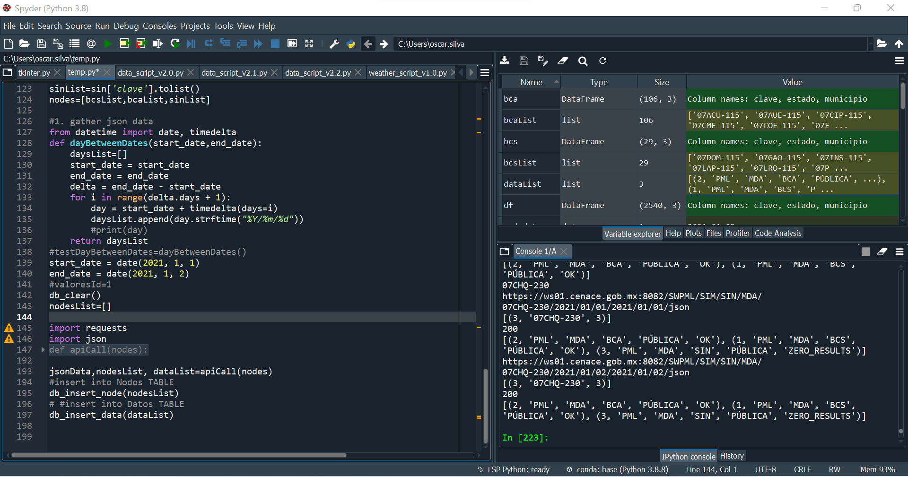
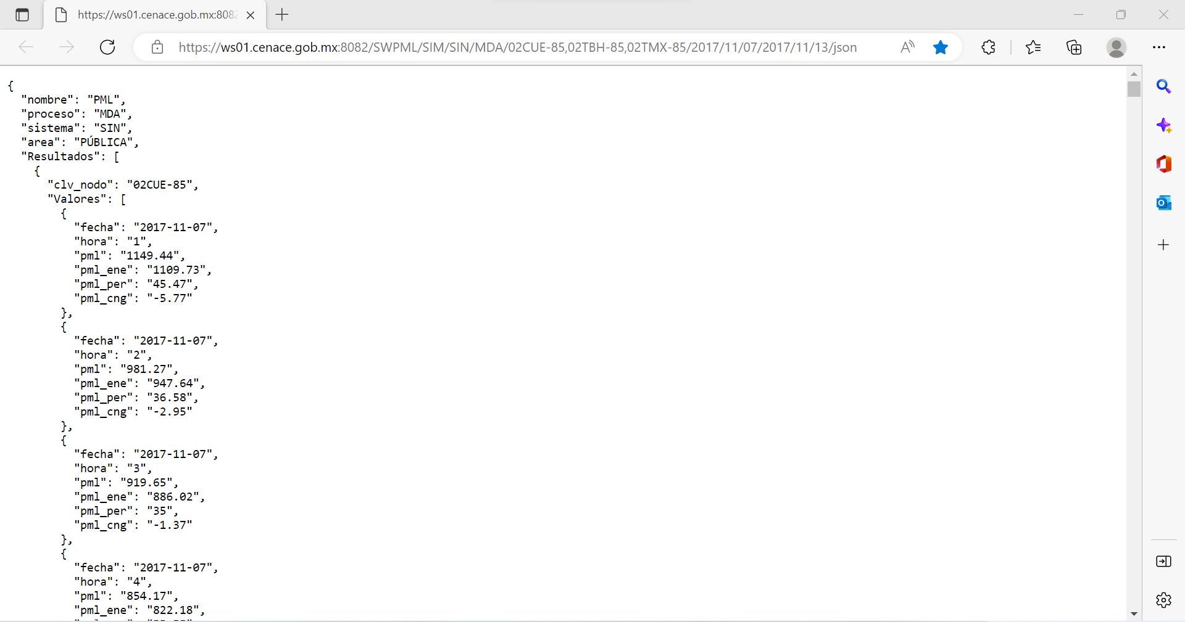
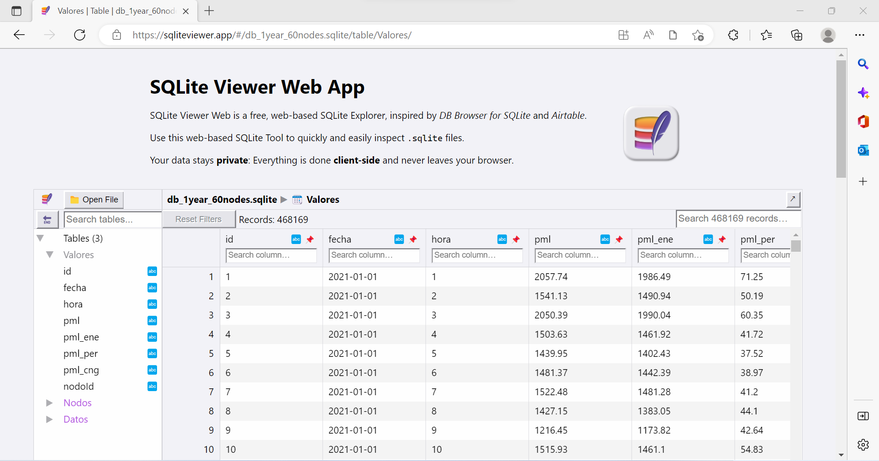
Python script for getting CENACE’s (National Energy Control Center) data from its Web service based on REST architecture API and store it in a normalized SQL database
Notes:
PML Price of electricity in a given node of the National Electric System for a defined period, calculated in accordance with the Market Rules and applicable to the electricity transactions carried out in the Wholesale Electricity Market.
PML MXN/MWh (Mexican pesos per energy).
Constraints: the web service only allows 6 days period calls on 20 nodes or less from 2017 to 2022
Challenges: being able to request a complete year of data on several nodes, clean the raw json data and give the proper format to be stored in a SQLite database (learn the technology), work with dates and time lapses

Slide 4
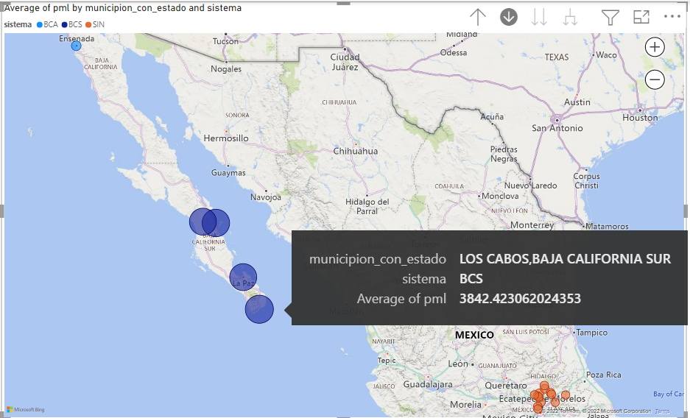
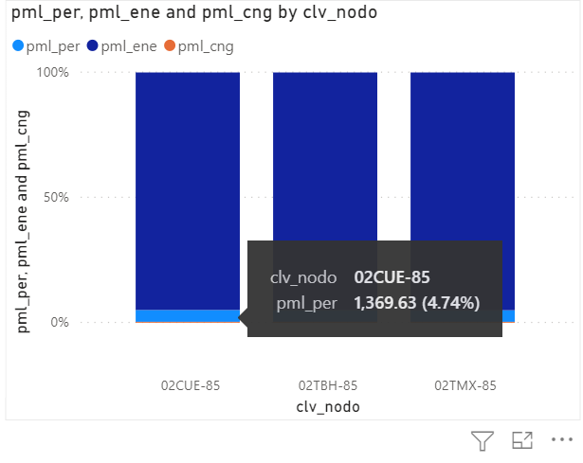
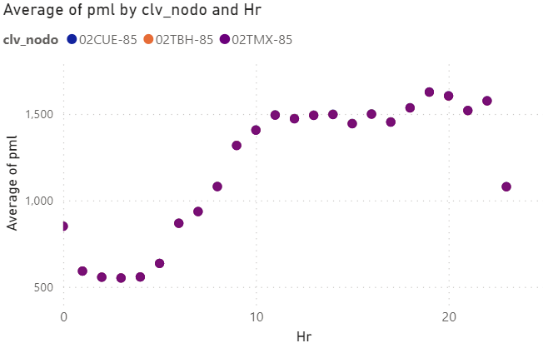
Import the database to Power BI in order to generate reports that show the Local Marginal Prices in the geography and by hour
Notes:
In the national electric system, all of Mexico is interconnected except the peninsula of Baja California that has two electric islands, this causes prices to be higher in this region.
Ensenada being an island and without being connected to the rest of the system, does not have such a high price since it is close to California and there is export and import.
We can also observe that on average the nodes have electrical losses of around 5%. We also can see congestion losses, which in this case does not affect greatly the electricity prices, nevertheless, there are other nodes where this component might have a higher impact on prices.
During the day and from 6:00 am there is a rise in prices due to the activity of people which reaches its highest point around 7:00 pm to fall back again at 11:00 pm

Slide 5
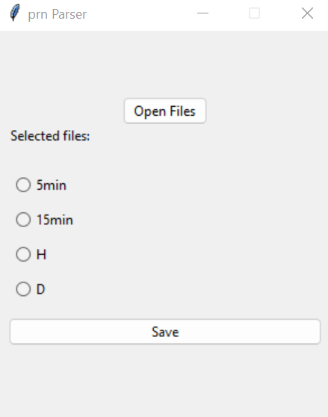
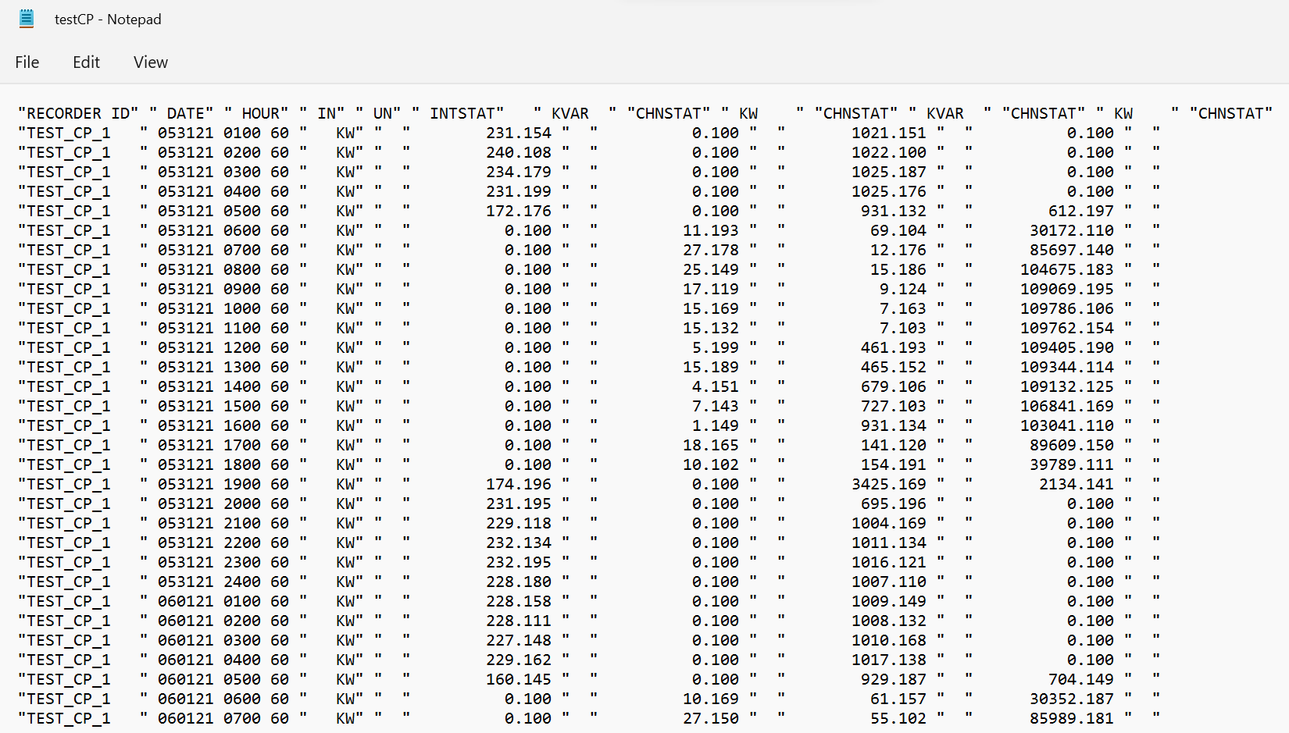
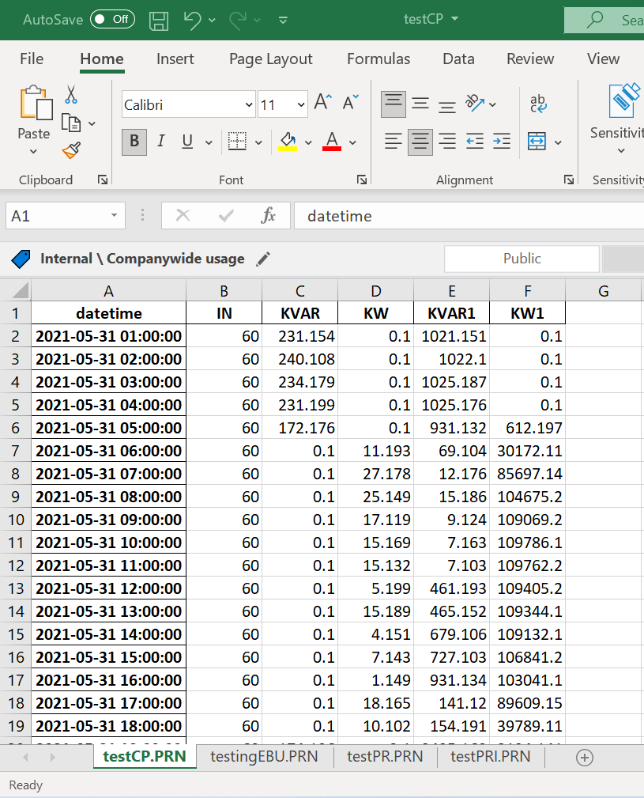
Tkinter desktop application (GUI) to parse a Lotus 1-2-3 spreadsheet into a Microsoft Excel Worksheet given the desired files and output directory
Notes:
Nextera software exports lotus1-2-3 files(.prn extension), there is a need to convert it into MS Excel Worksheet, a more common file (.xlsx extension) since Lotus is legacy software.

Slide 6
Portfolio
Python script for getting CENACE’s (National Energy Control Center) data from its Web service based on REST architecture API and store it in a normalized SQL database
Import the database to Power BI in order to generate reports that show the Local Marginal Prices in the geography, by hour, date etc.
Tkinter desktop application (GUI) to parse a Lotus 1-2-3 spreadsheet into a Microsoft Excel Worksheet given the desired files and output directory
Notes:
PML
Price of electricity in a given node of the National Electric System for a defined period, calculated in accordance with the Market Rules and applicable to the electricity transactions carried out in the Wholesale Electricity Market".

